Slide 1
Machine Learning
South Fayette Pilot

Slide 2
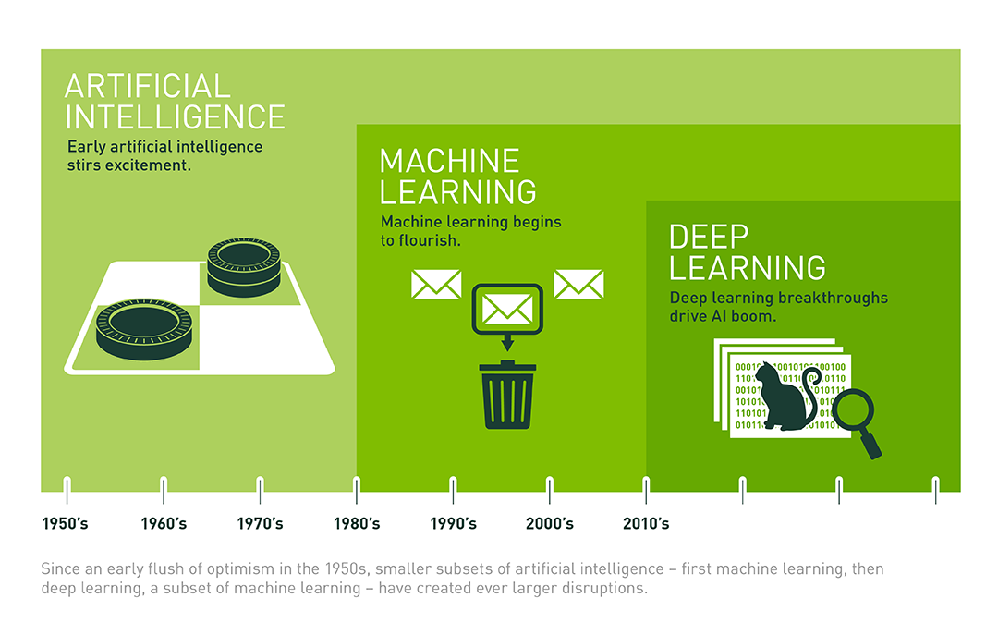
Selling your idea
What is Machine Learning?
The basic goal is to develop intelligent machines.
Many sub-goals:
Perception, reasoning, control/motion/manipulation, planning, communication, creativity, learning

Slide 3
Selling your idea
What is Machine Learning?
Three components:
Task, T
Performance measure, P
Experience, E
Tom Mitchell’s definition of learning:
A computer program LEARNS if its performance at tasks T, as measured by P, improves with experience E

Slide 4
Selling your idea
Examples:
Email Spam Detector:
Task T: to classify an email as spam or not
Performance Measure P: how accurate it is (based on user verification of whether an email is actually spam)
Experience E: all the emails it has and will see

Slide 5
Selling your idea
Examples:
Robotic Grasp:
Task T: to properly pick up an object
Performance Measure P: does it pick up the object, or does the object slip out of its grip?
Experience E: all the objects it will see and try to pick up

Slide 6
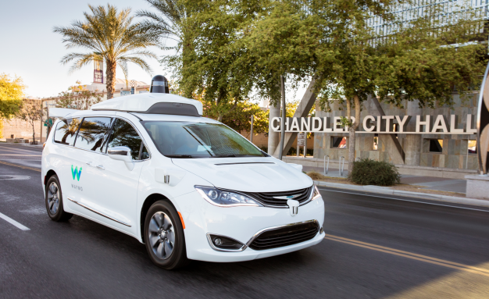
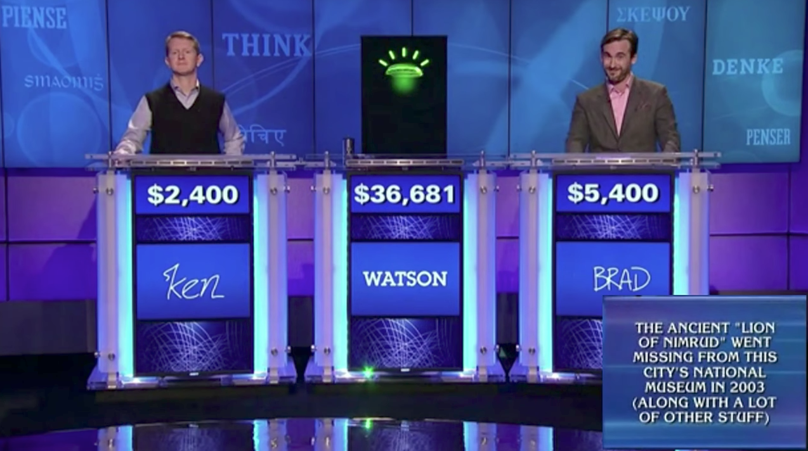
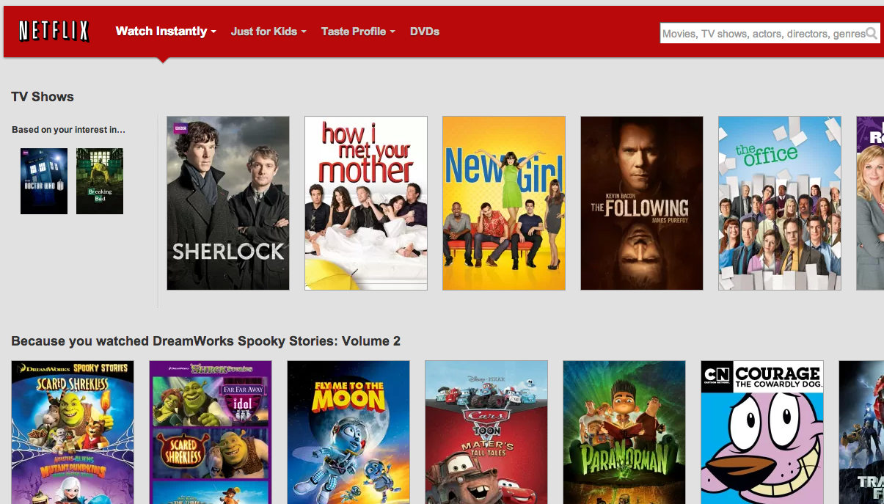
Machine Learning Examples:

Slide 7
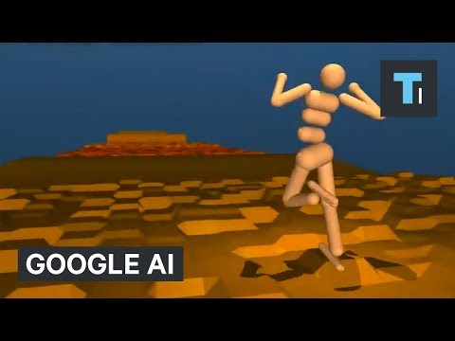

More examples:
Selling your idea

Slide 8
Prerequisites:
Fractions,
Algebra,
Basic Coding
Selling your idea

Slide 9
Rough Schedule Of Program:
Week 0: CS Refresher, Java->Python Transition
Weeks 1-3: Decision Trees
Weeks 4-6: Online Learning
Weeks 7-9: Clustering + Neural Nets
Selling your idea
Notes:
bit.ly/tkmlfeedback

